Slide 1
Mid-course Progress and Opportunities for Unidata Outreach
Ben Domenico
May 2011

Slide 2
Outline
Overview
Relationship to Unidata 2013 Proposal
Collaborating Communities
Recent Progress
Current Focus
Future Directions

Slide 3
Overview
Focus near the boundary of our core community
Make our data available more broadly and gain access to other data source in useful forms
Implement/support up to standard interface
Do NOT support other communities’ tools
Do NOT provide domain expertise
Employ bottom-up approach to standards
Get others to do most of the work

Slide 4
Unidata 2013 Review Panel Question
Question: Is the UPC prepared to provide the same quality of support to the newly engaged communities as it provides to its current constituents?
Response: While the support for all users will remain at a very high level, that does not mean it will be exactly the same.
Data access with supported analysis and display tools for our community
Data access via standard interfaces to enable other communities to use our data with their own tools (arcGIS, IDL, Matlab, etc.)

Slide 5
Excerpts from Review Panel Report
The UPC could play a significant leadership role within committees and consortiums like OGC seeking to address the need to develop standards and technologies for data discovery
Unidata leadership and advocacy in this area could facilitate expanded utilization of Unidata information resources for other research areas like climate and provide Unidata users with easier access to other data sources like NASA satellite information

Slide 6
Unidata 2013 Thematic Areas
Broadening participation and expanding community services
Advancing data services
Developing and deploying useful tools
Enhancing user support services
Providing leadership in cyberinfrastructure
Promoting diversity by expanding opportunities
Outreach initiatives contribute directly to thematic areas in red

Slide 7
Collaborating Communities
Oceanography
Conventions and Standards
Cross-cutting
Core Constituency:
U. S. Meteorology
Research and Education Community
Coastal Oceans
Societal Impacts
Hydrology
Hazards/ Extreme Events
Climate

Slide 8
Disparate Data Models: Different Ways of Thinking about Data
To the GIS (solid earth and societal impacts) community, the world is:
A collection of static features (e.g., roads, lakes, plots of land) with geographic footprints on the Earth (surface).
The features are discrete objects with attributes which can be stored and manipulated conveniently in a relational database.
To the fluids (atmosphere and oceans) communities, the world is:
A set of parameters (e.g., pressure, temperature, wind speed) which vary as continuous functions in 3-dimensional space and time.
The behavior of the parameters in space and time is governed by a set of equations.
Data are simply discrete points in the mathematical function space.
Each community is making progress in understanding and adapting to needs and strengths of the other. Progress areas will be highlighted
Notes:
In the realm of geolocated datasets, data stored in Geographic Information Systems (GIS) are highly structured and most often stored in an underlying relational database. While this may be a gross simplification, GIS datasets typically consist of “features” on the surface of the Earth that can be represented by points, lines and polygons. An example is a county plat which can show natural features such as streams and rivers, infrastructure like roads and bridges and buildings, and plots of land such as towns, lots, and so forth. The attributes of these features lend themselves to storage in the tables of a relational database. There can be a table for the roads, another for the towns, yet another for the rivers, etc. Each specific feature is a record in a table which provides a very useful way of keeping track of the characteristics of each instance of each feature.
Visualization is conceptualized in terms of a set of “layers.” In the physical world, transparent mylar sheets are often used to overlay various sets of features on a given base map. The same idea is used for manipulating the visualization of the classes of features in GIS visualization systems
Generally speaking, AS datasets are characterised by the following observational nature:
• high dimensionality (e.g. four or more dimensions);
• multivalued parameters, characterized by a tensor rank (e.g. a brightness temperature parameter can be characterized by several values, one for each acquisition channel; its rank is equal to the number of acquisition channels);
The VisAD data model assumes that data objects are approximations to mathematical functions.

Slide 9
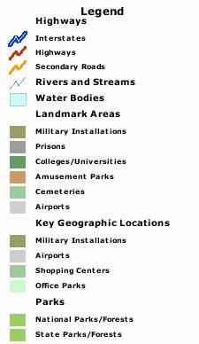
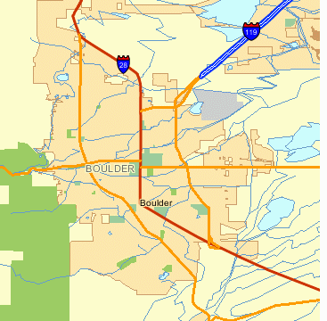
Traditional GIS view
Features as points, lines, polygons
Attributes in DBMS tables
Notes:
In the realm of geolocated datasets, data stored in Geographic Information Systems (GIS) are highly structured and most often stored in an underlying relational database. While this may be a gross simplification, GIS datasets typically consist of “features” on the surface of the Earth that can be represented by points, lines and polygons. An example is a county plat which can show natural features such as streams and rivers, infrastructure like roads and bridges and buildings, and plots of land such as towns, lots, and so forth. The attributes of these features lend themselves to storage in the tables of a relational database. There can be a table for the roads, another for the towns, yet another for the rivers, etc. Each specific feature is a record in a table which provides a very useful way of keeping track of the characteristics of each instance of each feature.
Visualization is conceptualized in terms of a set of “layers.” In the physical world, transparent mylar sheets are often used to overlay various sets of features on a given base map. The same idea is used for manipulating the visualization of the classes of features in GIS visualization systems

Slide 10
Typical NetCDF Visualization

Slide 11
Standard Interface Web Services for Data System Interoperability
GIS clients:
e.g., Google Earth,
arcGIS, IDL, Matlab, etc.
Unidata clients:
IDV, McIDAS,
GEMPAK, AWIPS
Proprietary GIS protocols
Standard protocols:
WMS, WFS, WCS, CSW
Community protocols: THREDDS, OPeNDAP, ADDE. FTP…
GIS Servers
Community Servers
GIS Server
THREDDS Server
GIS Server
THREDDS Server
Hydrologic, demographic, infrastructure, societal impacts, … datasets
Satellite, radar, forecast model output, … datasets

Slide 12
GIS Tools Applied to Atmospheric Science Data

Slide 13
A Few of the Collaborating Organizations
NOAA (e.g., PMEL, PFEL, NCDC, NGDC, IOOS?)
NASA
USGS
OGC (Open Geospatial Consortium)
CF (Climate and Forecast) Community
CUAHSI (Hydrology)
NCAR (GIS Program, CISL, …)
NEON (National Ecological Observatory Network) Data Services
International (Italian National Research Council, British Atmospheric Data Center, University of Reading E-science Center, Meteo France, Australian Bureau of Meteorology, …)
Industry (ESRI, ITTvis, Applied Science Associates, …)

Slide 14
Collaboration Illustration: ArcMAP Display of NCAR Data from THREDDS Web Map Server
NCAR model air temperature anomaly display
Data from NCAR climate model
TDS software from Unidata
WMS software from University of Reading
Server run by NCAR GIS program
GIS map and analysis software from ESRI

Slide 15
“Collateral Successes”
Annual average temperature directly read from netCDF file into ESRI arcMAP
Images can be accessed via WMS
Data can be accessed via WCS
Temporal animation now much more convenient in new versions of ESRI tools
Similar to earlier successes with IDL, Matlab, Ferret, GRaDs and many other analysis and display tools.

Slide 16
Recent Progress
netCDF adopted as (first) OGC binary encoding standard
netCDF read/write incorporated direction into ESRI arcGIS
Draft OGC spec for CF extension to netCDF core with Italian National Research Council (CNR)
Draft OGC spec for CF-netCDF extension to WCS with CNR
Working on extension spec for netCDF enhanced (netCDF4) data model
“Crossing the Digital Divide” data discovery experiment with CUAHSI and CNR
User community incorporating GI-cat catalog metadata harvesting for THREDDS Data Servers (Rich Signell created a configuration video.)
GEOSS arctic climate and weather demonstration with USGS, NCAR GIS, GMU, Michigan Tech
Harmonization of CSML and CDM scientific feature types with BADC and CF community
NCPP (NOAA Climate Projection Pilot) with NOAA, USGS, NCAR GIS, Michigan Tech)
WMO community joins OGC and MetOceans working group formed
OPeNDAP considering joining OGC
Discussed plans with CF community at recent GO-ESSP meetings
HDF5 is part of OGC Web Services phase 8 testbed
Hosting OGC Technical Committee and GEOSS Climate Workshop in Sept.
Participating in University Consortium for GIS and CUAHSI GIS in June
Participating in International Coastal Oceans Network 5 Workshop in August
Invited to international workshop on Networking of Air Quality Data Systems

Slide 17
Status of CF-netCDF OGC Standards Development Stefano Nativi, Italian National Research Council, Institute of Methodologies for Environmental Analysis, Prato, Italy
Ben Domenico, Unidata Program Center, University Corporation for Atmospheric Research, Boulder, USA
CF-netCDF application profiles
Forecast Model Output
Weather Station Obs
Satellite Imagery
Coastal Ocean Model
…
{
netCDF extensions
Irregular Grid
Java
Radial
Swath
HDF 5
ncML-GML
Fortran
Sampling Types
Point/Station ( Discrete Sampling)
64-bit offset
C
Grid
ncML
...
Classic
CDL
netCDF Enhanced
CF
...
…
...
...
...
Binary encodings
XML encodings
Text encodings
data model
conventions
APIs
CF-netCDF core
netCDF Classic Dataset
Legend:
Extension under development by OGC CF-netCDF SWG
abstract extension
categories
OGC CF-netCDF 1.0 as of January 2011
Possible future
extensions

Slide 18
Current Focus in OGC
CF extension to OGC netCDF core spec
CF-netCDF extension to WCS core spec
Enhanced data model (netCDF4) extension to netCDF core spec
CSML and CDM/CF Feature Types
Hosting September OGC Technical Committee Meetings

Slide 19
So What?
Activities foster awareness and adoption of Unidata infrastructure
More data systems compatible with Unidata tools and services
More data from different, organizations, disciplines, and regions discoverable – with documentation and in usable forms
Some organizations, e.g., in European Union, required by law to use standard-compliant software
Valuable international collaborations on development of tools and provision of services
New opportunities and work paradigms possible

Slide 20
New Possibility: Data Interactive Publications
Publications are the valued “exchange medium” of the academic community
Data citation (for transparency, reproducibility, etc.) is an emerging issue for scientific publications
Data access and analysis are the basis of nearly all those publications
In the present technological environment, can we bridge the gap between the publications and the data analysis?
Having data and processing on same system is efficient.
Will this work in an era of server side (cloud?) computing and mobile client devices?

Slide 21
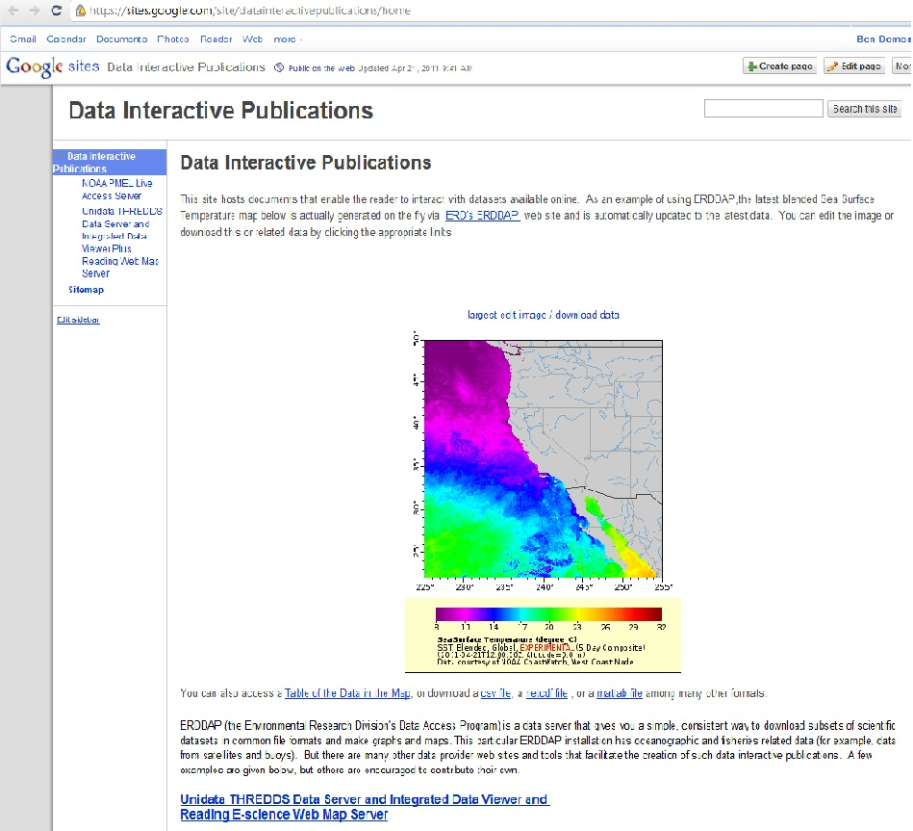
Data Interactive Publications
Browser-based Analysis and Display
GIS clients: arcGIS, IDL, Matlab, etc.
Unidata clients: IDV, McIDAS,
GEMPAK, AWIPS
Processing Services
WPS
Proprietary GIS protocols
Community protocols: THREDDS, OPeNDAP, ADDE, FTP, …
Standard Protocols: netCDF encoding via WMS, WFS, WCS, CSW
GIS Servers
Community Servers
GIS Server
THREDDS Server
GIS Server
THREDDS Server
Hydrologic, demographic, infrastructure, societal impacts, … datasets
Satellite, radar, forecast model output, … datasets

Slide 22
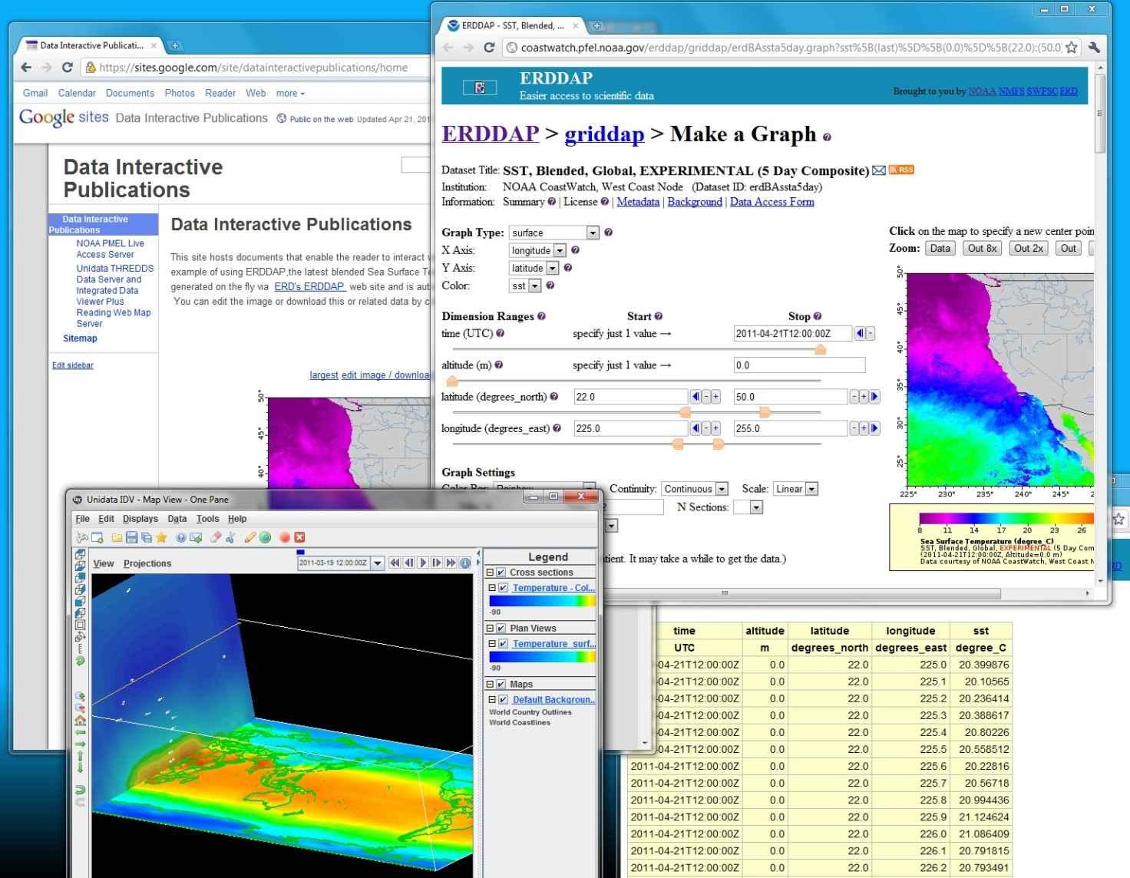
Via Standard Interfaces, Publications Enable Access to Distributed Processing, Tools, Data
Straightforward HTML documents can be created on public wiki or local web server.
Via embedded links, reader accesses data and analysis and display tools.
Tools can be:
thin web clients,
rich desktop applications.
From within the document, reader can interact with data via:
tools,
“live” tables
downloads.

Slide 23
Advantages
Convenient authoring of online publications that enable the reader to access and analyze the data cited in the publication
Community Incentive: makes “documentation” of data a rewarded part of an academic’s job
Transparency: fosters openness by providing broader and easier access to processing and data as well as products
Server flexibility: services can be on local workstation/cluster, on central server, in the cloud, or in Wyoming
Efficiency: processing can be performed near “big data” stores
Collaboration: could foster more NCAR/Unidata collaboration
Internal Cooperation: would involve both engineering and non-engineering staff within Unidata
Client flexibility: data analysis can be driven from mobile devices as well as desktop

Slide 24
Challenges
New way of thinking for developers and users
Additional effort: new or re-programmed staff
Persistence of all components: datasets, processing services, and interfaces
Computing resources: distribution and limitations
Security: authentication and authorization
Primitive web processing services at present
Interfaces are new and generally untried in an environment where people are relying on them
Need to engage publications industry

Slide 25
Publication on Google Sites Wiki
Online document created with simple wiki tools
Embedded images generated “on the fly” from another web site
Embedded links enable reader to:
access related datasets
perform one’s own analysis and display

Slide 26
Embedded Links to Online Data and Analysis Tools

Slide 27
Embedded Links to Datasets and Desktop Applications

Slide 28
Interoperability and Collaboration GFS 2.5 degree Surface Temperature
Forecast model output from US National Centers for Environmental Prediction
Real-time delivery via Unidata IDD
Stored in Unidata THREDDS Data Server motherlode
Dataset in
WMO GRIB2 files
Access via OGC WCS (Unidata), WMS (Reading e_Science), OPeNDAP (OPeNDAP Inc.), Unidata NetCDF Subset Service …
Unidata netCDF access via Unidata Common Data Model
Visualization via Reading GODIVA2
Hundreds of analysis and visualization tools work with Unidata netCDF datasets
Next slide

Slide 29
Google Earth Visualization Created on Unidata TDS with e-Sciences WMS/GODIVA

Slide 30
Implications of Recent Developments
Earlier barriers are being overcome:
Browser-based access to interactivity is becoming more common (Live Access Server, TDS/WMS/GODIVA, ERDDAP, FerretTDS…)
Server-side (cloud?) processing is a viable platform for interactivity
RAMADDA/TDS provides mechanism for persistent storage of datasets by user community
Clients with modest processing/storage ability come into play (tablets, smart phones)
Documents, data, storage, data access, processing capabilities, user devices can all be distributed
Processing can be co-located with large datasets.

Slide 31
Areas Needing Attention/Resources
TDS/RAMADDA authentication enabling user data input for persistent storage
Web processing services that enable more processing on server side (cloud?)
Simple apps on modest client platforms that enable interaction with data access AND PROCESSING services

Slide 32
Examples
General wiki-based publications at https://sites.google.com/site/datainteractivepublications/
TDS/ncWMS motherlode example: http://motherlode.ucar.edu/thredds/godiva2/godiva2.html?menu=&layer=Temperature_surface&elevation=0&scale=205.9,306.3&bbox=-142.03125,-68.203125,37.96875,72.421875&server=http://motherlode.ucar.edu/thredds/wms/fmrc/NCEP/GFS/Global_2p5deg/NCEP-GFS-Global_2p5deg_best.ncd
Live Access Server example: http://ferret.pmel.noaa.gov/NVODS/getUI.do?dsid=woa01_monthly&catid=0B541688EA4ACDF44451F0623AE315CF&varid=t0112an1
ERDDAP Example: http://www.pfeg.noaa.gov/~cwilson/bloom/BW_14.html

Slide 33
Remaining Slides Optional
If there is time, the rest of the slides can be the basis of a technical discussion of how to deal with different scientific data types.

Slide 34
How to Deal with Collections of Various Scientific Data Types
Point data from lightning strike observations
Station observations from fixed weather stations
Vertical profiles from balloon soundings and wind profilers
Trajectory data obtained from instruments onboard aircraft which have taken off and landed recently
Volumetric scans from ground-based radars
Visible, infrared, and water-vapor (and possibly other wavelength) satellite imagery
Gridded output from national or hemispheric weather forecasts (typically run at centers like NCEP and ECMWF) --sometimes used as boundary conditions for a higher-resolution local forecast model.

Slide 35
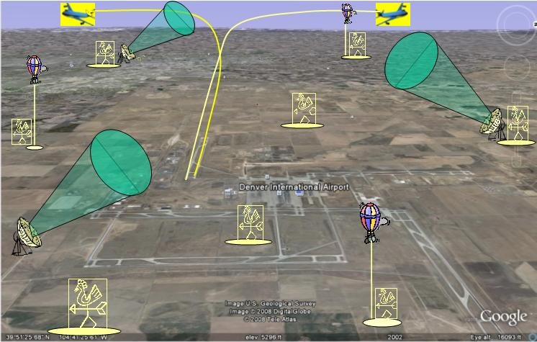
Airport Weather Use Case
Give me all the atmospheric observations and forecasts in a 3D bounding box around the airport during the time frame of a recent storm
Notes:
An illustration of the application of this simple data request for a wide variety of data types is given in Airport Weather Use Case and Related Standards. The idea underlying this catch-all use case is that a client wants all the atmospheric data available near an airport for a study of the behavior of storms in that region.

Slide 36
GALEON 1 Lessons
Relatively simple WCS use case is valuable:
Bounding box (in coordinate space), time frame, coverage name (e.g., surface temperature) subsetting is practical
CF-netCDF payload works for many clients
WCS limitations:
gridded data (regularly spaced in some projection
WCS 1.1 complicated (all things to all people)
WCS going toward modular core/extensions approach

Slide 37
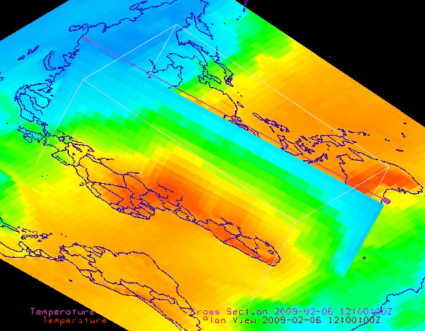
Gridded Output of Forecast Models
WCS is ideal for this scientific data type

Slide 38
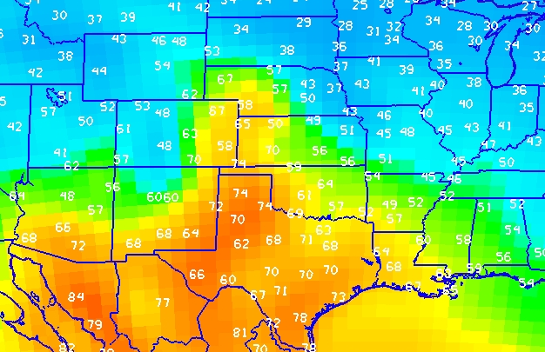
Collections of Station Observations
Common Use Case: comparing forecast and observations for the same region and time

Slide 39
Are These Collections Coverages?
Data request similar to that of WCS is useful for cases comparing forecasts and observations
ISO general feature model calls them “aggregations”
ISO 19123 definitions of coverage includes:
grid,
point
curve
surface
solid
But WCS only serves regular grids at this point

Slide 40
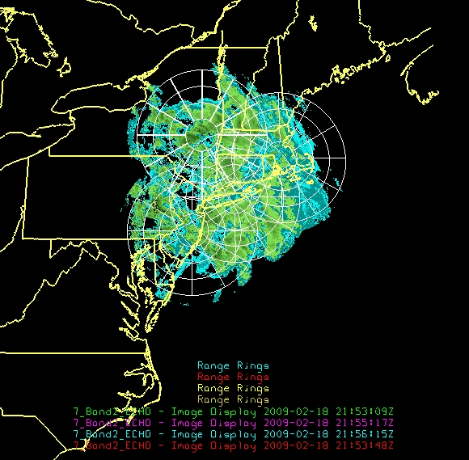
Radar Data Collections
Collections of data from individual radars look a lot like the gridded coverages output from weather forecast models or satellite imagery. But the “range rings in the animated illustration show clearly that determining the locations of individual data points is more complicated than for regularly spaced grids.

Slide 41
Data Access Alternatives
WCS was shown to work well in GALEON 1 for straightforward data access use case, but only for regularly-spaced grids
Points, trajectories, vertical profiles are thought of as “features,” but WFS has limitations when it comes to collections of features and the time dimension
SOS works for time series of observations from sensors, but not for space-time bounding box requests in its present form

Slide 42
Climate Science Modeling Language and Common Data Model Feature Types
Scientific Feature Types
CSML | CF/CDM
Point | Point
PointSeries | StationTimeSeries
Trajectory | Trajectory
Profile | Profile
ProfileSeries | StationProfile
Swath | Swath
ScanningRadar | StationayrRadialSweep
Section | Collection of Profiles
Grid | Grid (single time)
GridSeries | Grid

Slide 43
Alignment of CSML with CF Point Obs. (Quote from BADC CSML Group)
For several iteration now the Climate and Forecast (CF) conventions for Point Observations and CSML have been converging on similar feature models. The latest version of CSML sees very direct mappings between CSML and CF Point Observations (see also the Unidata Common Data Model). This will help bridge the gap between the netCDF and file view of the world and the OGC feature and service view.

Slide 44
Scientific Data Types Mapping to ISO Coverages (from 2009)
Unidata CDM Scientific Data Type | ISO 19123 Coverage Type
Unstructured Grid | DiscretePointCoverage*
Structured Grid | DiscreteGridPointCoverage
Swath | DiscreteSurfaceCoverage
Unconnected Points | DiscretePointCoverage*
Station observation/Timeseries | DiscretePointCoverage
General Trajectory | DiscretePointCoverage* or DiscreteCurveCoverage
Vertical Profile | DiscretePointCoverage*
Radar Radial | DiscreteSurfaceCoverage or DiscreteCurveCoverage
*Generally, the domain is a set of irregularly distributed points

Slide 45
Convergence of Scientific Data and Feature Types
O&M 1.0
O&M 1.0
O&M 2.0
WXXM 1.0
WXXM 1.1
WXXM 2.X
Aligned with
WXXM Builds
on CSML 3.X
(XML encoding)
O&M 2.0
CSML 1.0
CSML 2.X
CSML 3.X
Aligned with
Aligned with
Unidata CDM
Unidata CDM
Unidata CDM
(Binary encoding)
Thanks to Aaron Brackle and Ted Habermann

Slide 46
References
CSML http://csml.badc.rl.ac.uk/
CF Conventions http://cf-pcmdi.llnl.gov/
Unidata Common Data Model http://www.unidata.ucar.edu/software/netcdf-java/CDM/

Slide 47
Future Opportunities
Develop “final” agreement on scientific feature types with OGC CSML, CDM, CF
Finalize CF conventions for station/point (discrete sampling) features
Establish collections of station/point data as recognized ISO/OGC coverages.
Participate in/guide CF conventions for radar, swath, unstructured grids
Bring additional data types into OGC
Style layer descriptors for MetOceans datasets

